Slide 1
9-13-16
AH ENGLISH II MS. P

Slide 2
Bellringer
Composition notebooks:
Tuesday: ACT Minutes: 9-12-16
Get out a sheet of paper for your quiz.
First and last name
Date
Period
Word Wall Test 1-18
Version ______
Homework:
Last word wall homework for this 9 wks
Vocab cartoons for words 19-30
19. inevitable 25. supposition
20. lucid 26. inferences
21. lurid 27. ambiguity
22. precipitate 28. grotesque
23. prostrate 29. sated
24. ravenous defiled
When you finish your assessment, turn it in to designated space & work on handout. If you finish, turn it in to the bin when you leave. If you don’t, it is homework and due at the start of class tomorrow.

Slide 3
Week Five

Slide 4
1. A restaurant occupying the top floor of a skyscraper rotates as diners enjoy the view. Ling and Sarah notice that they began their meal at 7:00 p.m. looking due north. At 7:45 p.m. they had rotated 180 degrees to a view that was due south. At this rate, how many degrees will the restaurant rotate in one hour?
A. 90 degrees
B. 180 degrees
C. 240 degrees
D. 270 degrees

Slide 5
2. Your friend shows you a scale drawing of her apartment. The drawing of the apartment is a rectangle 4 inches by 6 inches. Your friend wants to know the length of the shorter side of the apartment. If she knows that the length of the longer side of the apartment is 30 feet, how many feet long is the shorter side of her apartment?
A. 9
B. 20
C. 24
D. 30

Slide 6
3. If 12 vases cost $18.00, what is the cost of 1 vase?
A. $0.67
B. $1.05
C. $1.33
D. $1.50

Slide 7
4. A company earned a profit of $8.0 million each year for 3 consecutive years. For each of the next 2 years, the company earned a profit of $9.0 million. For this 5-year period, what was the company’s average yearly profit, in millions of dollars?
A. 8.2
B. 8.25
C. 8.4
D. 8.5

Slide 8
5. A company rents moving vans for a rental fee of $25.00 per day with an additional charge of $0.30 per mile that the van is driven. Which of the following expressions represents the cost, in dollars, of renting a van for 1 day and driving it m miles?
A. 0.30m + 25
B. 25m + 30
C. 30m + 25
D. 55m

Slide 9
Answers:
1. C
2. B
3. D
4. C
5. A

Slide 10
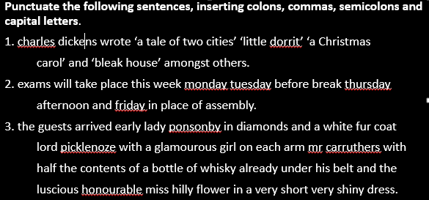
Word Wall Assessment 1-18
When you finish your assessment, turn it in to designated space & work on handout. If you finish, turn it in to the bin when you leave. If you don’t, it is homework and due at the start of class tomorrow. No excuses.
Last word wall homework for this 9 wks. Due Tuesday, 9-19-16 before the final word wall test for this grading period.
Vocab cartoons for words 19-30
19. inevitable 25.supposition
20. lucid 26. inferences
21. lurid 27. ambiguity
22. precipitate 28. grotesque
23. prostrate 29. sated
24. ravenous 30. defiled
Yesterday’s exit slip, in case you didn’t finish:

Slide 11
Punctuate the following sentences, inserting colons, commas, semicolons and capital letters.
1. Charles Dickens wrote: ‘A Tale of Two Cities’, ‘Little Dorrit’, ‘A Christmas
Carol’, and ‘Bleak House’, amongst others.
2. Exams will take place this week: Monday; Tuesday, before break; Thursday
afternoon; and Friday, in place of assembly.
3. The guests arrived early: Lady Ponsonby, in diamonds and a white fur coat;
Lord Picklenoze, with a glamourous girl on each arm; Mr. Carruthers, with
half the contents of a bottle of whisky already under his belt; and the
luscious, honourable Miss Hilly Flower, in a very short very shiny dress.

