Slide 1
Bellringer
Please grab your composition notebooks and date: 8-16-16 and ACT minutes.

Slide 2
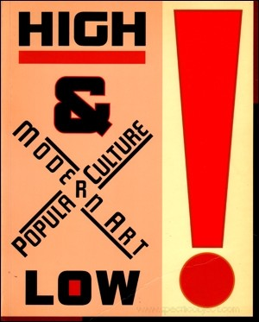
Cultural Distinctions
High, Folk, and Popular Culture

Slide 3

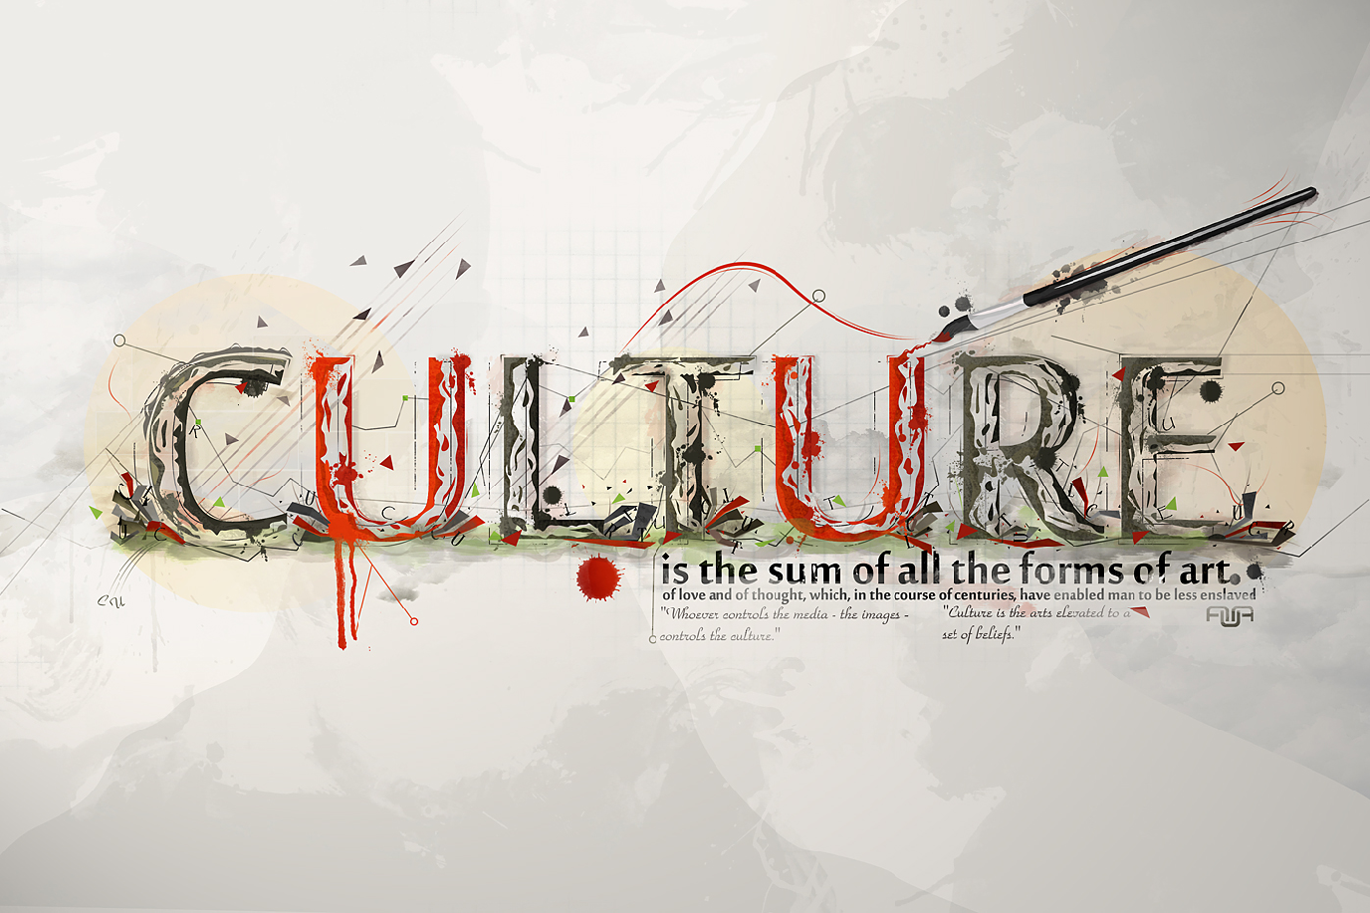
“Culture" is divisible into different types - high, popular, and folk are the most common distinctions.

Slide 4
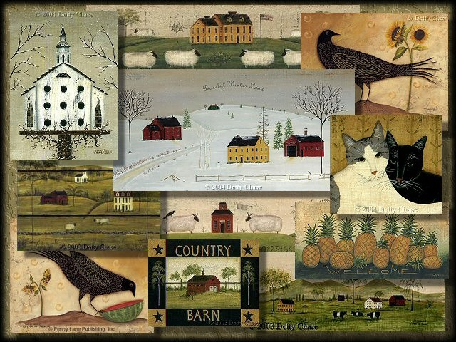
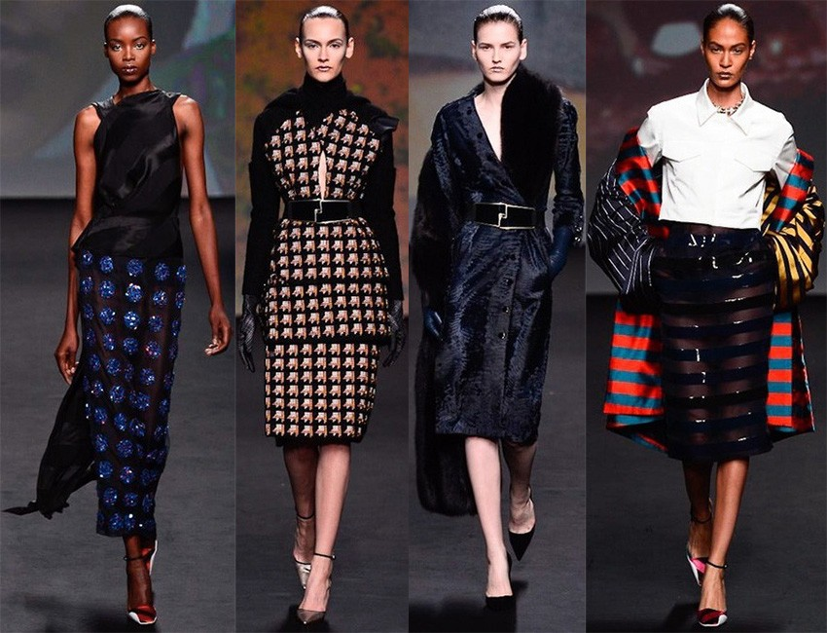
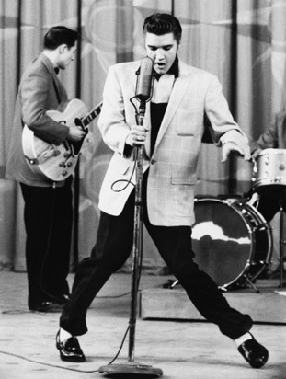
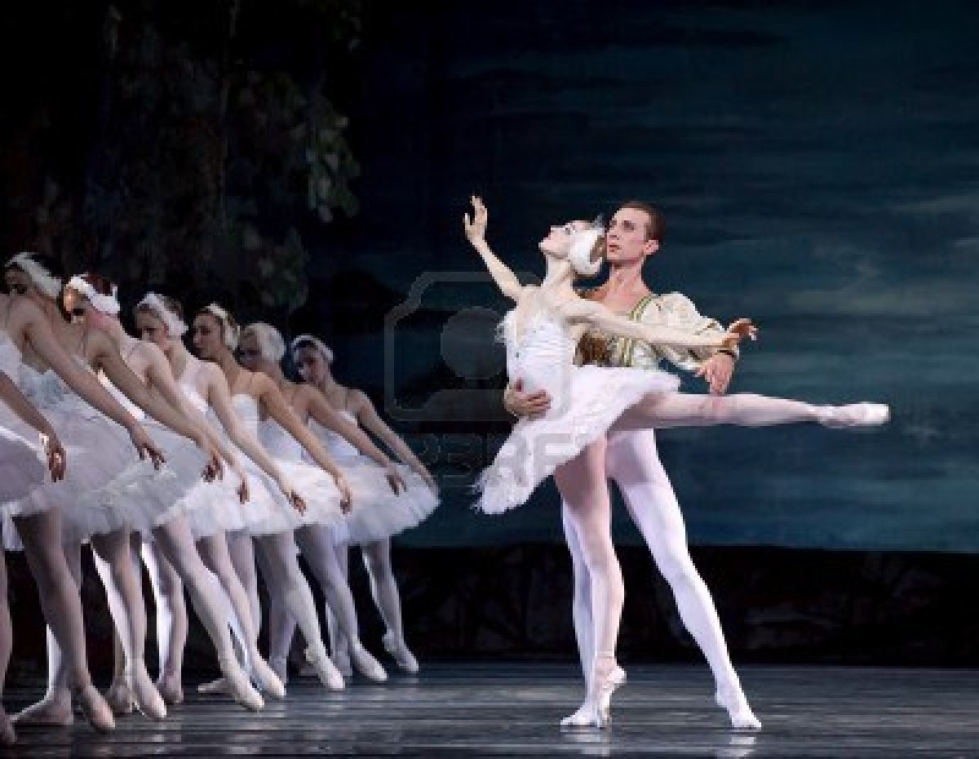
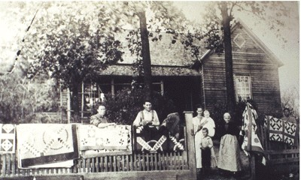
3

Slide 5
How Lobster Got Fancy
Read this article.
Turn to a partner and answer:
How was lobster viewed in the early days (1622)?
  What did it symbolize if people had lobster shells around the house?
How was lobster viewed in the 1940s?
  Give examples to show how lobster was consumed, and therefore viewed, in this time period.
How did the lobster “move up” in the world?
  What other brand examples are given in this article that started out with a low perception?

Slide 6
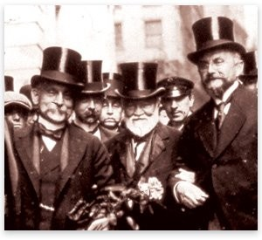
In ancient times (prior to writing), oral performance was accessible to the whole community. After the adoption of writing and as classes of society began to emerge over centuries, an elite culture began to distinguish itself from the folk culture of the people.
In the United States, the Industrial
Revolution created a new upper class elite of successful entrepreneurs, bankers and businesspeople.
– The nouveau riche and those who came from old money both used class cultures as a way of drawing boundaries between the classes.

Slide 7
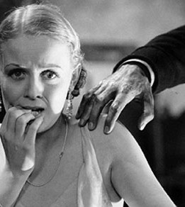
With the growing economic gap, some feared that the lower
classes posed a cultural danger to the
elite. Though there had always been the idea of culture - of
fine things, of education, of breeding, of taste.

Slide 8
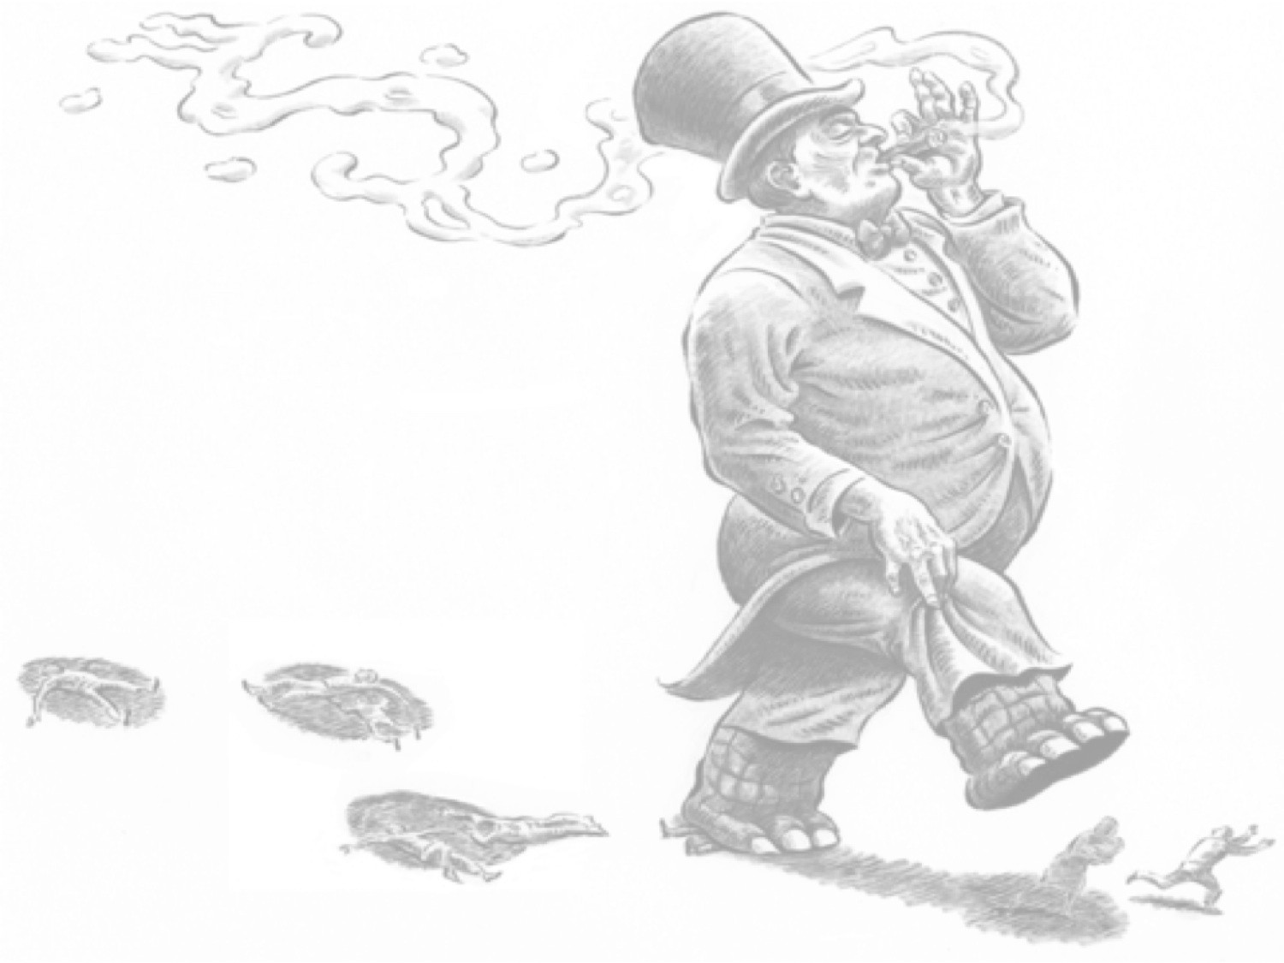
For years, culture was believed to be "the best that has been thought and said in the
world." Many believed that culture was the natural possession of the upper class
– Remember the theory of Social Darwinism was widely supported in this time. The rich believed that the working class was actually a less evolved form of life, which was why vulgarity and unruliness were inherent characteristics of their class. In the eyes of the rich/ elites, had little to nothing to offer society other than their labor.

Slide 9
The rich believed that it was their own knowledge and participation in culture that made them more civilized than the lower classes, and it was therefore their duty to impart "culture" to everyone else.
The significance of this idea of culture is that it associated culture specifically with the upper classes (with education, wealth, and good upbringing.)
The culture of the upper classes, their music, their art, their literature, their manners, and their values were believed to be the best the world had to offer.
The music, art, literature, etc. of the working class therefore was worthless, boring and vulger.

Slide 10
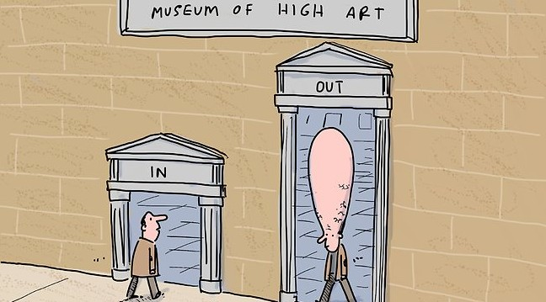

Slide 11
Characteristics of High Culture
The audience for high culture is small, therefore the creator/ artist is usually easily associated with their work (i.e., not mass produced.)
Created not for financial success but instead for the timeless recognition of having introduced the world to a new way of seeing, hearing, feeling or experiencing life.
– “Creation is a purely aesthetic act in pursuit of truth and beauty…. “Art for art’s sake’ is a phrase generally applied… The art piece is designed aggressively to confront us, to challenge our assumptions and beliefs about art and life, and to identify the unanswered questions about existence.”
High culture today includes the work of artists like Picasso, Shakespeare, Beethoven, etc.
9

Slide 12
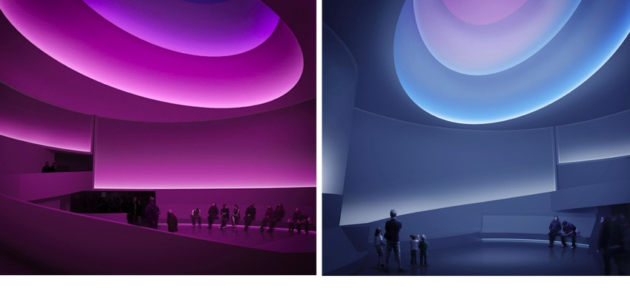
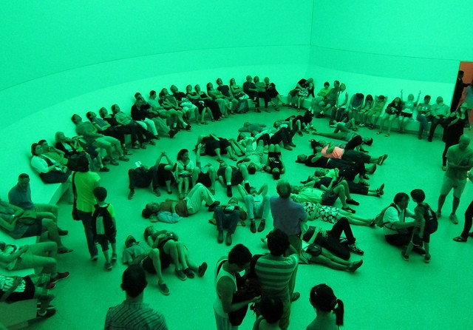
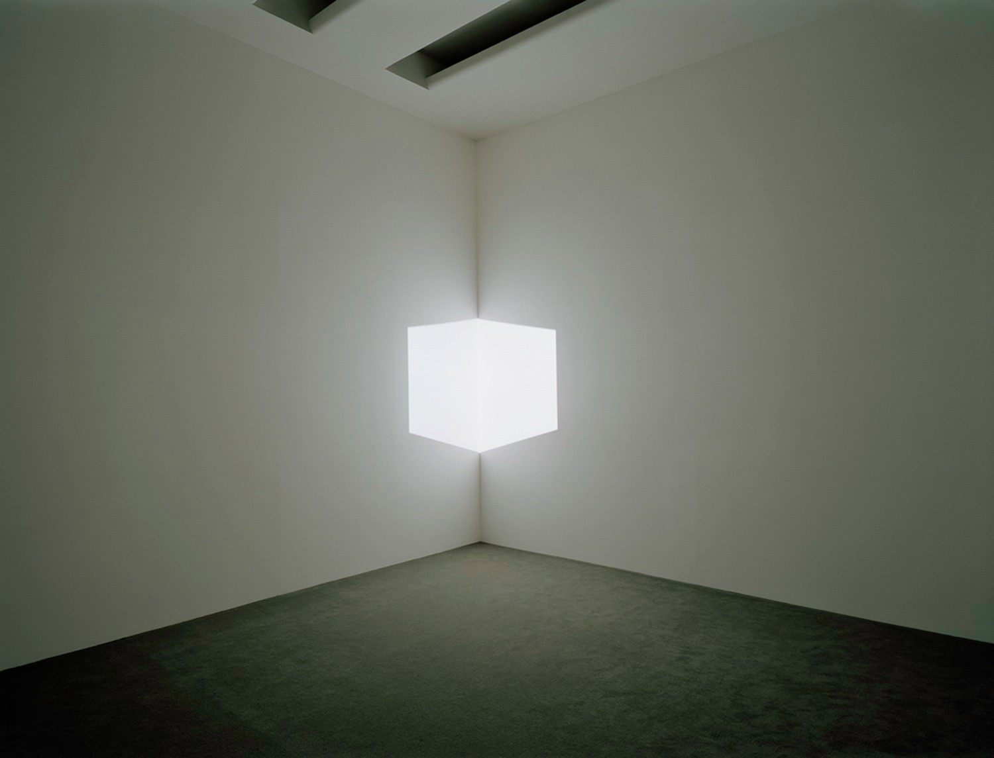
10

Slide 13
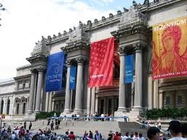
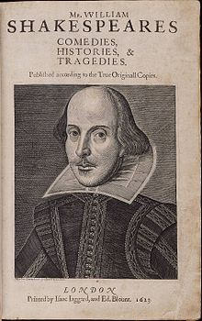
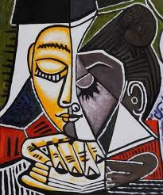
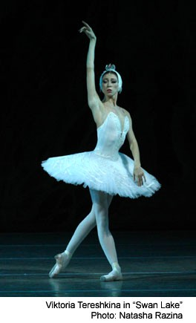
Examples of High Culture
11

Slide 14

Moving Beyond High Culture
If the aristocrats, politicians, intellectuals and other elite members of
society were the only people who possessed culture, to be doled out to the rest of society, then what do we do with the "culture" of the masses?
12

Slide 15
Recognition & Acceptance of Folk Culture
“Folk culture” was all the craze in the late 19th century.
Academics became focused on preserving this culture in fairytales, folksongs, proverbs, and dialects (led by the Brothers Grimm.)
Although folk culture stemmed from the lowest class - mostly farmers, peasants and villagers - it was not considered a threat to society, because it was a culture in decline, doomed to perish in the wake of industrialization
and urbanization.
13

Slide 16
Characteristics of Folk Culture
Created communally based on tradition and the everyday experiences of a social group. Folk culture has been described as
personal because it is based on people’s own shared personal experiences.
The creator and their audience belong to the same small society.
Made up of people/objects who represent or maintain a “traditional” way of life.
Not commercial – created not for profit but rather to reflect traditions and life experiences of the group.
Audience is small and limited to the group in which the folk culture is made. Folk culture generally has a limited appeal to outsiders of the society.
Typically isolated in rural areas.
Folk culture includes folk music, folk art, folktales, local jokes, oral
history, home remedies, old wives’ tales, superstitions, etc.
14

Slide 17
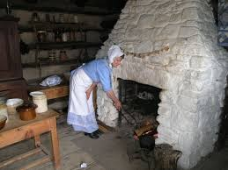
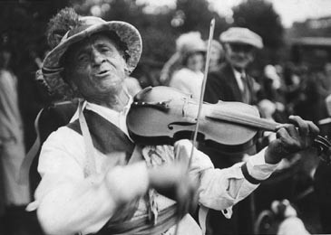
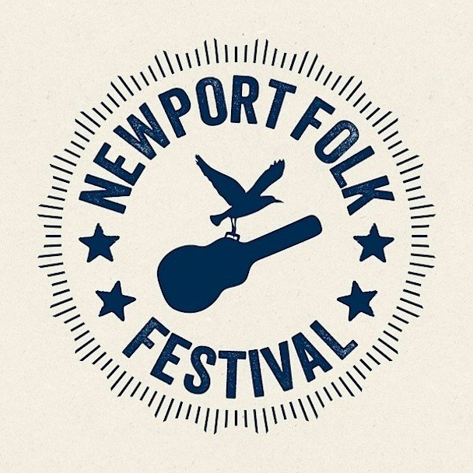
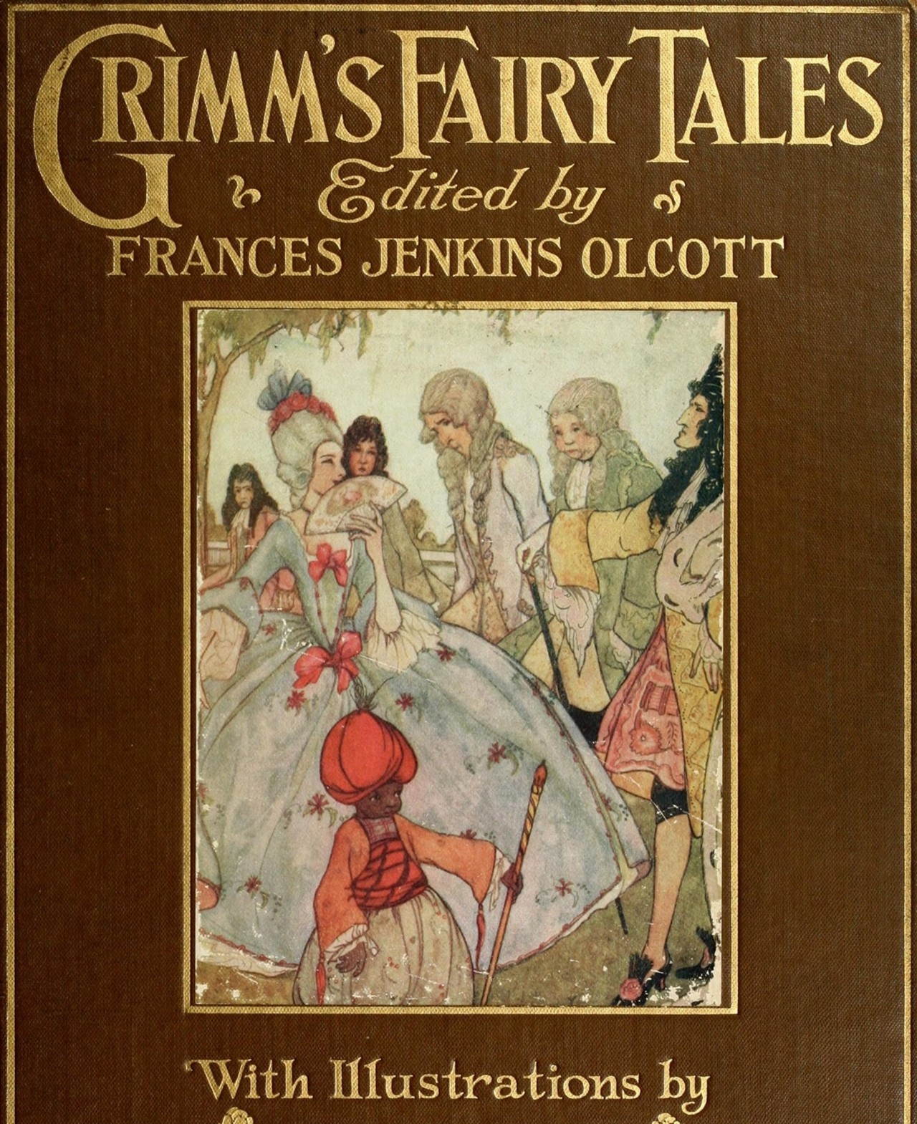
Examples of Folk Culture
15

Slide 18
Activity
Partner Up!
With your partner, jot down some examples of folk culture that you know. For example, share something distinct that is common in “your” culture. This could be specific to your ethnicity, or specific to your family’s culture. Think, for Nashville, common folk culture examples include cowboy boots, hats, and the southern drawl.
In my Korean culture, we offer food to guests as a symbol of love and acceptance. To reject eating is to reject the host! Even if you aren’t hungry, if my mom offers you food you better EAT!

Slide 20

High culture and folk culture only represented a very small percentage of the population, even put together. A large number of people were left hanging in the middle, with activities, past-times, and entertainments unworthy, so it seemed, of a label.
The need to address this latter type of culture became dire as the culture, or the un-culture, of the masses became increasingly prevalent in cheap novels, newspapers, comic strips, advertising and especially in the new inventions of film and radio in early the twentieth century. It was their culture that came to be called the contentious "mass" or "popular culture”.

Slide 21

The first academic interest in popular culture (in the 1930s) began negatively, with the condemnation of any
culture that fell outside of the traditional, educated, and elitist class.
'Mass culture' was the term designated for the Hollywood-movie goers, the romance readers, and the radio show listeners, but the term was used mockingly.
– As far as historians were concerned, this mass culture was a hollow imitation of true culture. It taught nothing, it conveyed no worthwhile messages, and it had no value. Instead, mass culture worked as a type of drug, lulling its audience into a false perception of reality, deadening them to the true difficulties of life.

Slide 22
Consider how the tv/internet/video games are often regarded today…

Slide 23
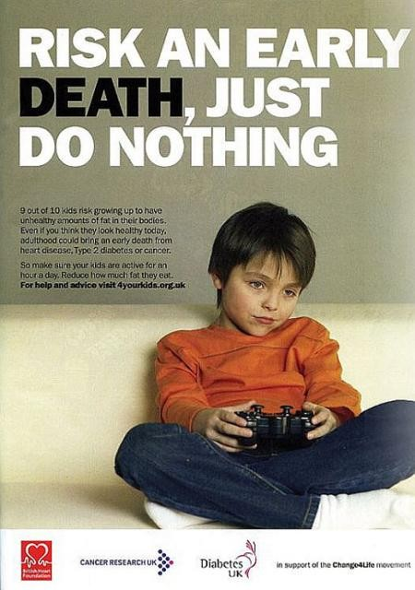
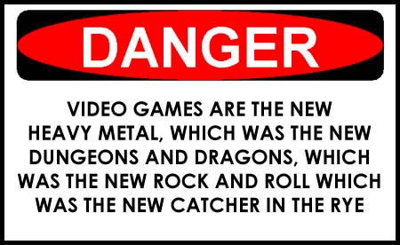

Slide 24
Characteristics of Popular Culture
The audience for pop culture is usually quite large (hence the label “popular.”)
Due to the large number of people it aims to please, it cannot draw on the traditions of a small group (unlike folk culture.)
Pop culture must be novel enough to hook attention, but not so novel as to make people question their beliefs.
  Popular culture has, in this century, been quite innovative in its use of media, particularly media which can communicate to a large number of people at once: the radio, film, television, the internet.
Finally, despite the association of popular with mass markets, many creators of popular culture are in their business simply because they love to create (though there a sizeable number in it for the money.)

Slide 25
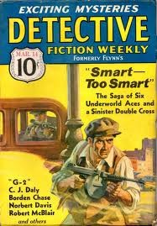
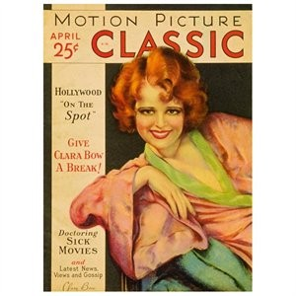
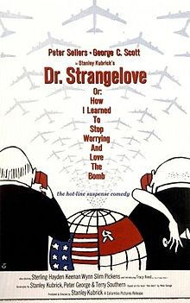
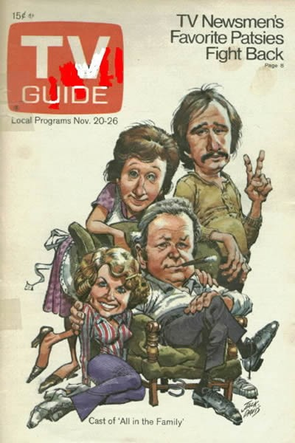
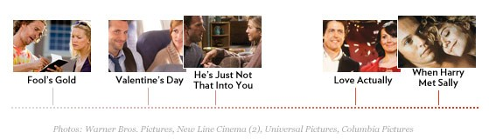
Examples of Popular Culture
21

Slide 26

The Problem:
The line between high, folk, and popular culture can get blurry…

Slide 27
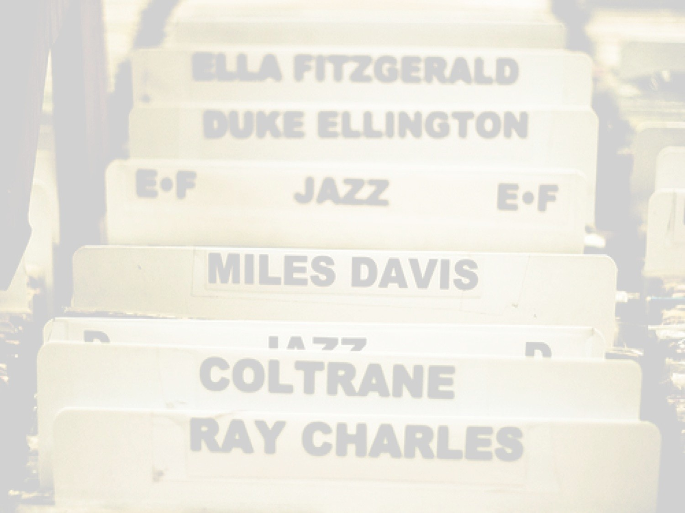
Consider Jazz & the Blues
Arose our of the poorest communities in America
Became a huge commercial seller in the mid-1900s and artists became household names (Dizzy Gillespie, Miles Davis, John Coltrane, Billie Holiday, Count Bassie, etc.)
Today, an appreciation of jazz and blues is a status symbol

Slide 28

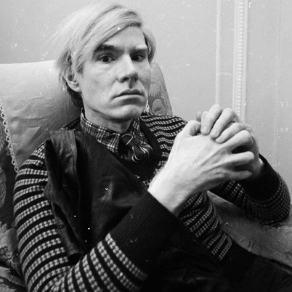
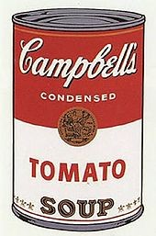
Another example: Andy Warhol
Originator of “pop art” – he directly challenged the notion of high art by choosing mundane topics for his art.
Painting a Campbell’s soup can in an innovative way, his goal was to question what gets classified as art.
– His soup can images, among others, were mass produced on a printing press, oftentimes by people other than him, they were mass marketed, and mass consumed are pop culture.
Today, his prints are considered high art when viewed in museums. What about when these images are mass produced on post cards, t-shirts, etc.?
24

Slide 29
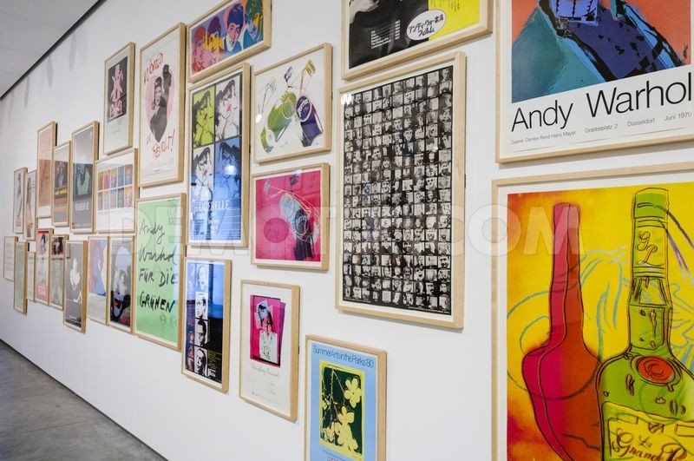
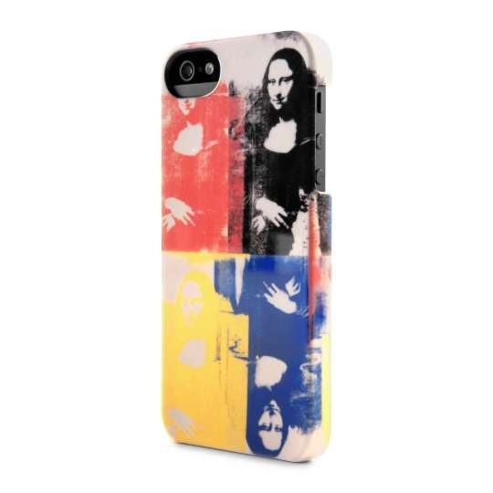
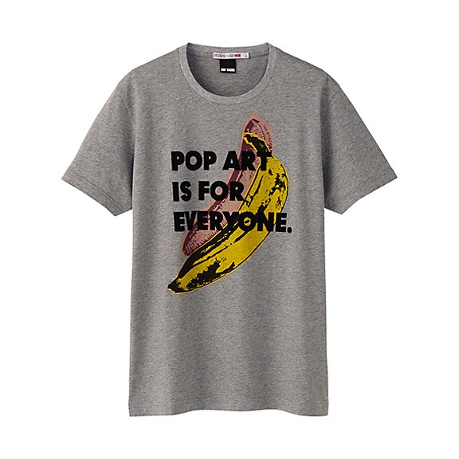
“An artist is someone who produces things that people don’t need to have but that he – for some reason – thinks it would be a good idea to give them.”
“Art is anything you can get away with.”
25

Slide 30
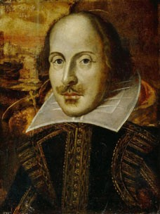
One Last Example: Shakespeare
In his time, he was widely popular and wrote for a popular audience.
Many of his plays sought to capture popular themes of the day (Italian Renaissance, nationalism, rulers, etc.)
Over time, his plays underwent a move from entertainment for the masses to education and enlightenment associated with the elite.
Yet his plays have been mass-produced in print, on stage, in film (in many versions and adaptations) and some of the lines from his plays have become so common that their
origins sometimes get lost (“to be or not to be…”
26

Slide 31
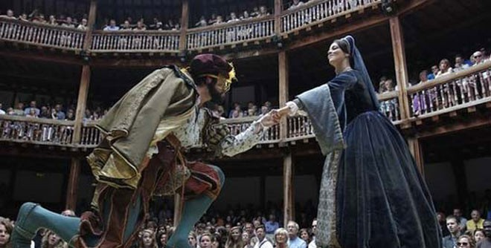
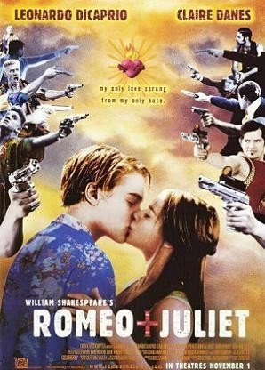
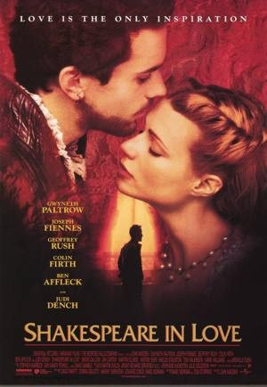
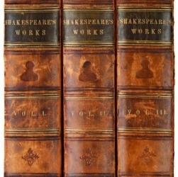
2
7

